Slide 1
String Searching Algorithm
By
Rachit Bundela Priya Jain Sachin Hegde

Slide 2
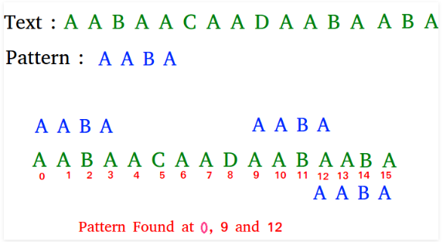
Introduction
The Pattern Searching algorithms are sometimes also referred to as String Searching Algorithms and are considered as a part of the String algorithms. These algorithms are useful in the case of searching a string within another string.

Slide 3
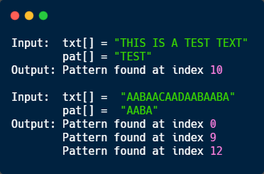
Rabin-Karp Algorithm
Problem: prints all occurrences of pat[ ] in txt[ ]

Slide 4
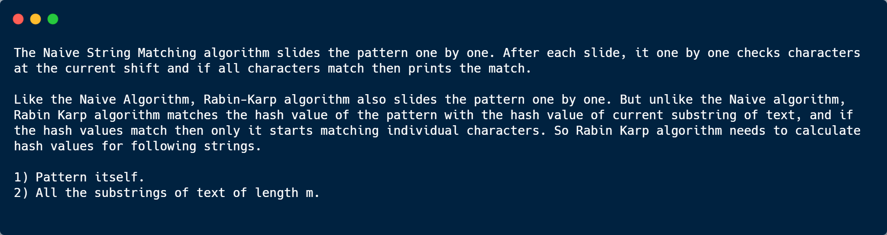
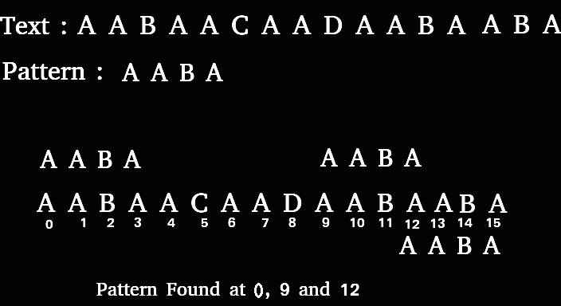

Slide 5
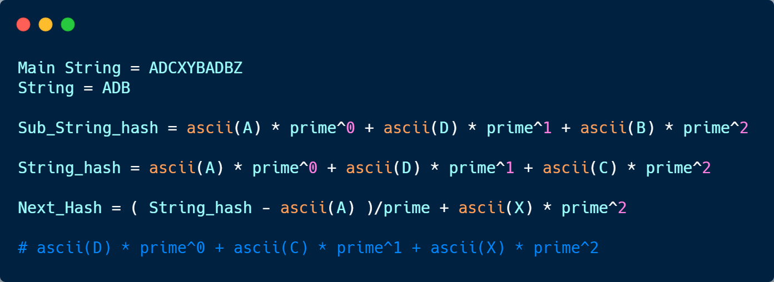
Calculating Hash

Slide 6
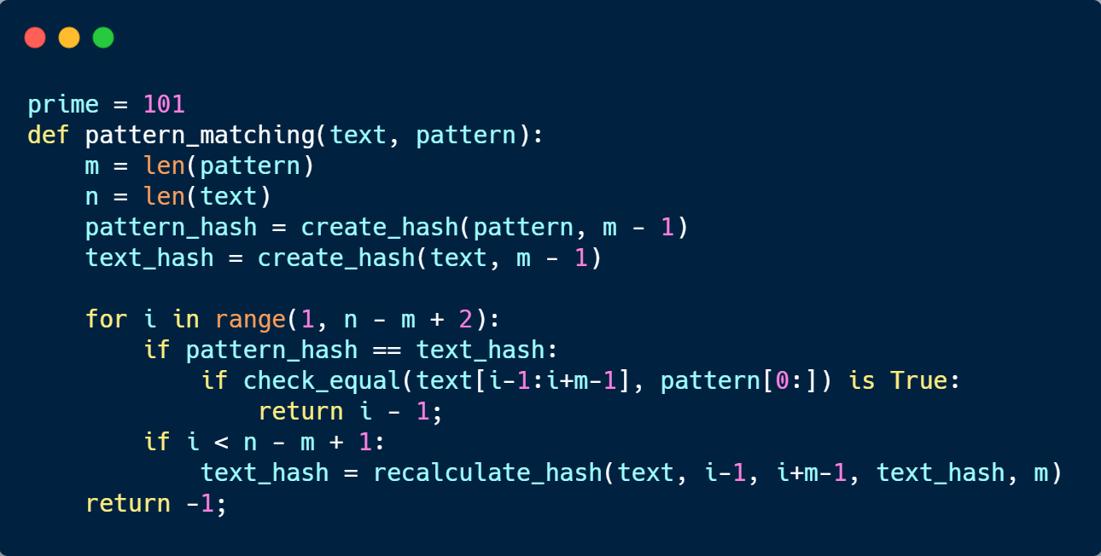
Algorithm

Slide 7
VISUALIZATION

Slide 8
KMP - Knuth Morris Pratt Algorithm
Knuth, Morris and Pratt discovered ﬁrst linear time string-matching algorithm by analysis of the naive algorithm.
It keeps the information that naive approach wasted gathered during the scan of the text. By avoiding this waste of information, it achieves a running time of O(m + n).
The implementation of Knuth-Morris-Pratt algorithm is efﬁcient because it minimizes the total number of comparisons of the pattern against the input string.
Knuth-Morris-Pratt String Search Visualization

Slide 9
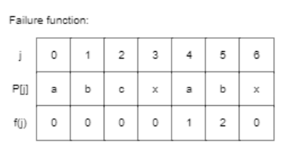
Calculating Reset Table Algorithm
Preprocessing Algorithm:
In the preprocessing part, we calculate values in reset[]. To do that, we keep track of the length of the longest prefix suffix value (we use len variable for this purpose) for the previous index. We initialize reset[0] and len as 0. If pat[len] and pat[i] match, we increment len by 1 and assign the incremented value to reset[i]. If pat[i] and pat[len] do not match and len is not 0,
we update len to reset[len-1].
Input:Text: abaabcxabcxabxa
Pattern: abcxabx

Slide 10
Searching Algorithm
We start comparison of pat[j] with j = 0 with characters of current window of text.
We keep matching characters txt[i] and pat[j] and keep incrementing i and j while pat[j] and txt[i] keep matching.
When we see a mismatch
We know that characters pat[0..j-1] match with txt[i-j…i-1] (Note that j starts with 0 and increment it only when there is a match).
We also know (from above definition) that reset[j-1] is count of characters of pat[0…j-1] that are both proper prefix and suffix.
From above two points, we can conclude that we do not need to match these reset[j-1] characters with txt[i-j…i-1] because we know that these characters will anyway match.

Slide 11
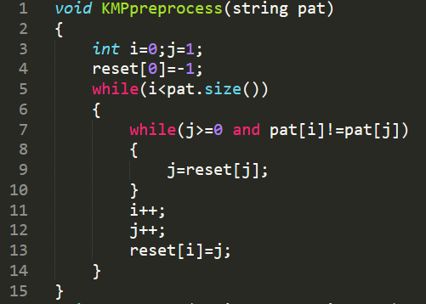
Implementation

Slide 12
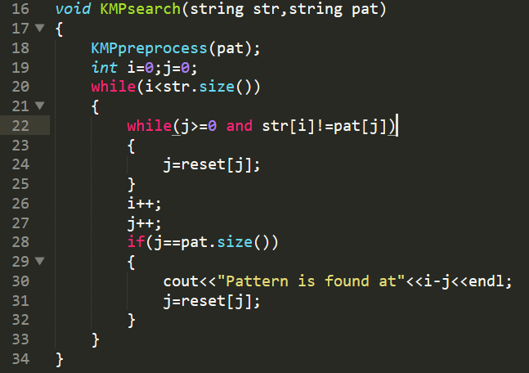

Slide 13
Z Algorithm
To find all occurrences of a pattern in a text in linear time, we use Z algorithm. Total time taken by this algorithm is O(m + n) with linear space complexity where length of text ‘n’ and of pattern ‘m’. Here both time and space complexity is same as KMP algorithm but this algorithm is Simpler to understand.
Here, we construct Z array. For a string str[0...n-1], Z array is of same length as string. An element Z[i] of Z array stores length of the longest substring starting from str[i] which is also a prefix of str[0...n-1].
The first entry of Z array is meaningless as complete string is always prefix of itself.

Slide 14
Example
Index 0 1 2 3 4 5 6 7 8
Text a a a b a c a a a
Compare a a a b a c a a a
Z values X
2
1
0
1
0
3
2 1
Visual Representation

Slide 15
Example continued...
Here, The idea is to concatenate pattern and text, and create a string “P$T” where P is pattern, $ is a special character should not be present in pattern and text, and T is text. Build the Z array for concatenated string. In Z array, if Z value at any point is equal to pattern length, then pattern is present at that point.
Pattern P = "aab", Text T = "baabaa"
The concatenated string is, Z = "aab$baabaa"
Z array for above concatenated string is {x, 1, 0, 0, 0, 3, 1, 0, 2, 1}.
Since length of pattern is 3, the value 3 in Z array indicates presence of pattern.

Slide 16
Algorithm
The idea is to maintain an interval [L, R] which is the interval with max R
such that [L,R] is prefix substring (substring which is also prefix).
1) If i > R then there is no prefix substring that starts before i and ends after i, so we reset L and R and compute new [L,R] by comparing str[0..] to str[i..] and get Z[i] (R-L+1).
2) If i <= R then let K = i-L, now Z[i] >= min(Z[K], R-i+1) because str[i..] matches with str[K..] for at least R-i+1 characters (they are in [L,R] interval which we know is a prefix substring).
If Z[K] < R-i+1 then there is no prefix substring starting at str[i] (otherwise Z[K] would be larger) so Z[i] = Z[K] and interval [L,R] remains same.
If Z[K] >= R-i+1 then it is possible to extend the [L,R] interval thus we will set L as i and start matching from str[R] onwards and get new R then we will update interval [L,R] and calculate Z[i] (R-L+1).

Slide 17


